Slide 1



2020
概率论答疑：第1章
董新宇 信管
……

Slide 2
Random Experiments &
Sample space
01
PART 01

Slide 3
Random Experiments
1
real or hypothetical process satisfying
the above three conditions.
The experiment can be repeated indefinitely under essentially the same conditions
Def.
2
3
The possible outcomes may not be unique and can be identified ahead of time.
The outcome is uncertain before the experiment

Slide 4
Sample Space
Definition 1.2.1.
● The collection of all possible outcomes of an experiment is called the sample space of the experiment, denoted by Ω or S.
● The elements in sample space are called sample points or basic events.

Slide 5
Operations between Events
02
PART 02

Slide 6
Remark
1
A ∩ B = B ∩ A,A ∩ A = A,A ∩ A^{c} = ∅, A ∩ ∅ = ∅,A ∩ S = A.
2
if A ⊂ B , then A ∩ B = A.
3
A − B = AB^{c} = A − AB.
4
A − B is not same as B − A
5
It is said that two sets A and B are disjoint, or mutually exclusive, if A∩B = AB = ∅.
6
For n sets A1,··· ,An, if any two of them are disjoint, then they are called pairwise disjoint events

Slide 7

Important Remark
● Associative Property
A ∪ B ∪ C = (A ∪ B) ∪ C = A ∪ (B ∪ C)
A ∩ B ∩ C = (A ∩ B) ∩ C = A ∩ (B ∩ C)
● Distributive Properties
A ∩ (B ∪ C) = (A ∩ B) ∪ (A ∩ C)
A ∪ (B ∩ C) = (A ∪ B) ∩ (A ∪ C)
● De Morgan’s Laws
(A ∪ B)^{c} = A^{c} ∩ B^{c},(A ∩ B)^{c} = A^{c} ∪ B^{c}
${\text{(∩}A_{i})}^{c}$= ∪$A_{i}^{c}{\text{, }\text{(∪}A_{i})}^{c}$= $\text{∩} A_{i}^{c}$

Slide 8
古典概型
Equally Likely Outcomes Model
03
PART 03

Slide 9
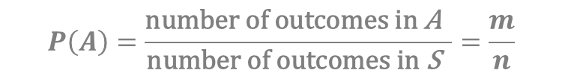
定义
(1) The sample space S contains only a finite number of points s₁,··· ,s_{n}.
(2)The probability assigned to each of the outcomes s₁,··· ,s_{n} is1/n
$$P\left(A\right)=\frac{\text{number} \text{of} \text{outcomes} \text{in} \text{A} }{\text{number} \text{of} \text{outcomes} \text{in} \text{S} }=\frac{m}{n}$$

Slide 10
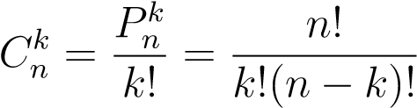
Selecting k of the elements one at a time without replacement from a set of n elements.
排列和组合
Suppose that an experiment has k steps (k ≥ 2), that the i-th step can have n_{i} possible outcomes (i = 1,··· ,k), then the total number of elements in S will be equal to the product n₁ × n₂ × ··· × n_{k}.
Consider a set with n elements. Each subset of size k chosen from this set is called a combination, the number of distinct such combinations is

Slide 11
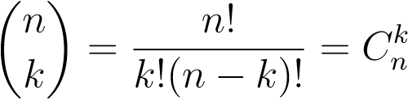
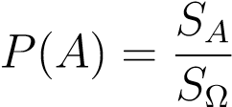
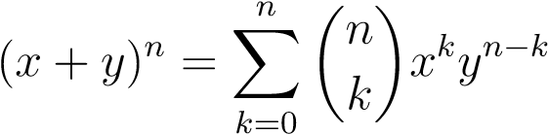
Remark

Slide 12
条件概率
Conditional Probability
04
PART 03

Slide 13
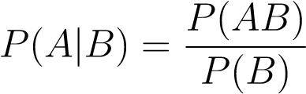
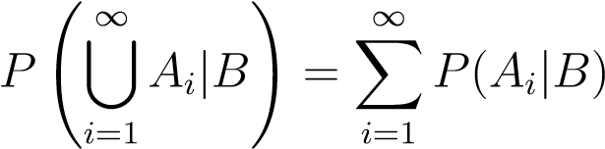
If P(B) > 0
Nonnegativity
A
B
Normality: P(S|B) = 1,
P(A|B) + P(A^{c}|B) = 1.

Slide 14
P(A ∩ B) = P(B) × P(A|B)
Let A and B be events. If P(B) > 0, then
P(A ∩ B) = P(A) × P(B|A)
If P(A) > 0, then
Suppose that A₁,A₂,··· ,A_{n} are events such that P(A₁ ∩ A₂ ··· ∩ A_{n−1}) > 0. Then
P(A₁ ∩ A₂ ··· ∩ A_{n}) = P(A₁)P(A₂|A₁)···P(A_{n}|A₁A₂ ···A_{n−1}).

Slide 15
全概率公式和贝叶斯定理
Total Probability and Bayes’ Theorem
05
PART 03

Slide 16

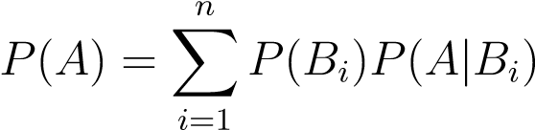
全概率
Let S denote the sample space of some experiment, and consider n events B₁,··· ,B_{n} in S such that
(1) B₁,··· ,B_{k} are disjoint;
Then these events are called a partition of S.
B
B
1
2
A
B
B
B
5
4
3

Slide 17
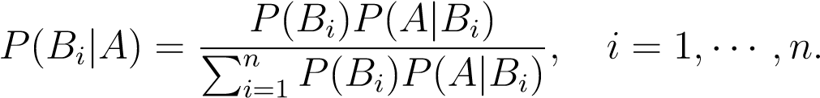
贝叶斯定理
01
Suppose that the events B₁,··· ,B_{n} form a partition of the space S and P(B_{i}) > 0 for i = 1,··· ,n. and let A be an event such that P(A) > 0, Then,
OPTION

Slide 18
独立事件
Independent Events
06
PART 03

Slide 19
If two events A and B are independent, and P(B) > 0, then P(A|B) = P(A).
1
Two events A and B are independent
P(A ∩ B) = P(A) × P(B).
2
A and B^{c}, A^{c} and B, A^{c} and B^{c} are also independent.
3
P(A_{i1} ∩ A_{i2} ··· ∩ A_{ik}) = P(A_{i1})P(A_{i2})···P(A_{ik}).

Slide 20
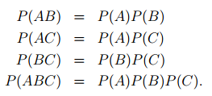
Three events A,B, and C are pairwise independent if the first three relations above are satisfied.

Slide 21
1. 在区间（0,1）中随机取两个数，则事件两数之和小于6/5的概率为
2. 已知随机事件A的概率P(A)=0.5,随机事件B的概率P(B)=0.6，条件概率P(B|A)=0.8，则P(A+B)=
3.已知事件A，B仅发生一个的概率为0.3，且P(A)+P(B)=0.5，则A，B至少有一个不发生的概率为
4. 10个同规格的零件中混入3个次品，现逐个检查，则查完五个零件时正好查出三个次品的概率为
5.已知两个事件A、B满足P(AB)=P(Cu(A∩B)), 且P(A)=p, 则P(B)=

Slide 22
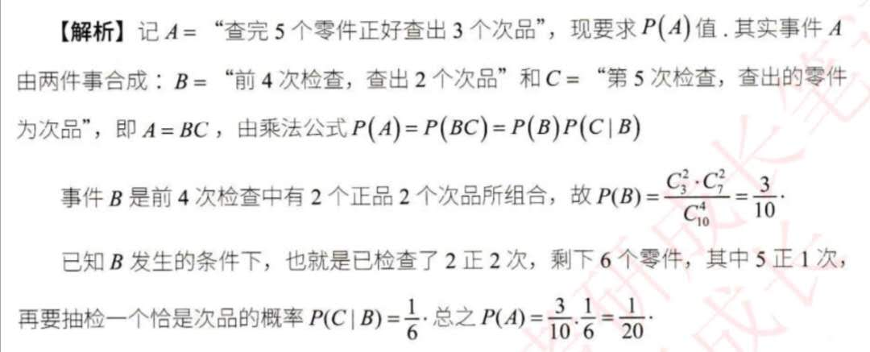
题 4

Slide 23
1.The event that at least one of A, B, C occurs is
2. An urn contains 10 balls numbered from 1 to 10. If three balls are taken, the probability that the maximum number of them is 5 is
3. A and B are two random events. P(A)=0.4, P(B）=0.3，P(A ∪ B)=0.6,thenP(A ∩ B^{c})=

Slide 24
2020
谢谢

